Slide 1

Olist e-commerce data set project
ML1 research team

Slide 2
starting notes
Project 2
does not have to use the same dataset as project one, but it is encouraged
2 tasks – either 2 of same or 1 of each
classification (example: can we correctly classify a product’s category from olist)
regression
can we predict a product’s price
can we predict if a consumer will purchase based on the shipping costs (based on the LABS article I shared on slack)
“according to research, up to 90% of Brazilian consumers have given up on a purchase because of shipping costs” – LABS article (https://labsnews.com/en/articles/ecommerce/brazil-ecommerce-shopping-dates/)

Slide 3
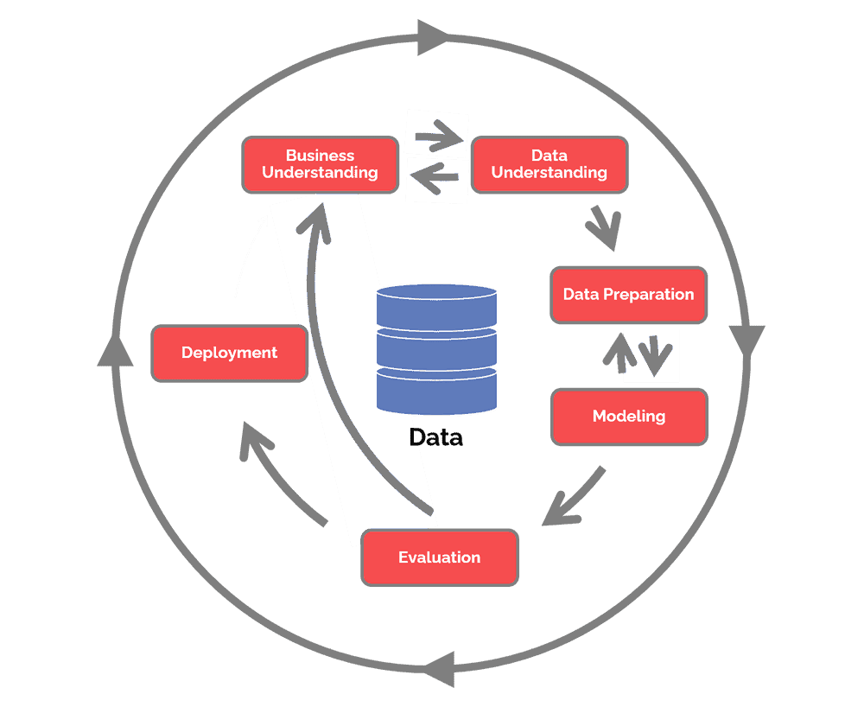
CRISP-DM (simplified)
Business understanding – What does the business need?
Data understanding – What data do we have / need? Is it clean?
Data preparation – How do we organize the data for modeling?
Modeling – What modeling techniques should we apply?
Evaluation – Which model best meets the business objectives?
Deployment – How do stakeholders access the results?

Slide 4

grading rubric
Business Understanding [10 pts total]
Data Understanding [80 pts total]
Business Understanding [10 points]
Data Quality [15 points]
Simple Statistics [10 points]
Visualize Attributes [15 points]
Explore Join Attributes [15 points]
Explore Attributes and Class [10 points]
New Features [5 points]
Exceptional Work [10pts total]

Slide 5
business understanding [10 pts]
Describe the purpose of the data set you selected (i.e., why was this data collected in the first place?).
Olist, a Brazilian E-commerce site provided a robust dataset of orders made at the Olist Store. The data set consists of roughly 100,000 orders from 2016 to 2018 and is multidimensional covering order information, consumer information, seller information, geolocation information, product attributes and customer reviews. The dataset will allow us to meet our stated business objectives. We will process the data using a combination of Python for data cleaning, mining, wrangling, exploration, feature selection and data modeling. and will possibly employ cloud services for tasks such as running sentiment analysis.
Describe how you would define and measure the outcomes from the dataset. That is, why is this data important and how do you know if you have mined useful knowledge from the dataset?
How would you measure the effectiveness of a good prediction algorithm? Be specific.
A major success factor will be to obtain accuracy of at least 85%, precision of at least 80%, sensitivity of at least 85%. These values are subject to review, contingent upon exploratory data analyses.

Slide 6

data understanding [80 pts]
[10 points] Data Meaning Type
Describe the meaning and type of data (scale, values, etc.) for each attribute in the data file.
Initial dataframe included 40 attributes from the original dataset that came from merging the following csv files:
orders, customers, order_items, order_payments, sellers, products, category_name_translation, order_reviews (note geolocation was not initially used because it was added to the original dataset in a later iteration and will be assessed during the data exploration if it should be added in)

Slide 8
data understanding [80 pts]
[ [15 points] Data Quality
Verify data quality: Explain any missing values, duplicate data, and outliers. Are those mistakes? How do you deal with these problems? Be specific.
Missing included in the Kaggle data specs, but here’s some explanations:
For each of the single values missing from the weight, length and width, it turned out that was the same record, so it was easier to just drop it from the dataframe.
For the 14 missing order_approved_at values, those each had both an order_status of delivered and a timestamp of when the order was delivered to the customer. We checked on the overall average time it takes for an order payment to be approved from the time the order is placed and it was about 10.5 hours, so to impute those missing values we just copied the order_purchased_timestamp value.
There are 2,515 orders missing a customer delivery date. Of those missing delivery dates it appears there were 564 cancelled orders, 7 orders that were unavailable, 8 orders that show as delivered but are missing delivery dates and 364 orders that were invoiced but there is no record of the orders being delivered. Other reasons we don't have delivery data is because at the time the data was pulled, an order could've been shipped, processing or approved or otherwise still in the process of making its way to the customer. These are just good things to note, we may consider just removing all 2,515 lines since we have so much data already. There were 7 orders that were cancelled, but still delivered and more than likely that's because the order was cancelled after it shipped from the seller.

Slide 9
data understanding [80 pts]
[10 points] Simple Statistics
Give simple, appropriate statistics (range, mode, mean, median, variance, counts, etc.) for the most important attributes and describe what they mean or if you found something interesting. Note: You can also use data from other sources for comparison. Explain the significance of the statistics run and why they are meaningful.

Slide 10
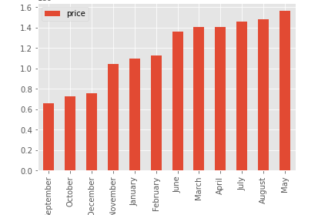
data understanding [80 pts]
[15 points] Visualize Attributes
Visualize the most important attributes appropriately (at least 5 attributes). Important: Provide an interpretation for each chart. Explain for each attribute why the chosen visualization is appropriate.
Sales by Month (also we have the LABS article to refer to)
ipsum
ipsum
ipsum
ipsum

Slide 11
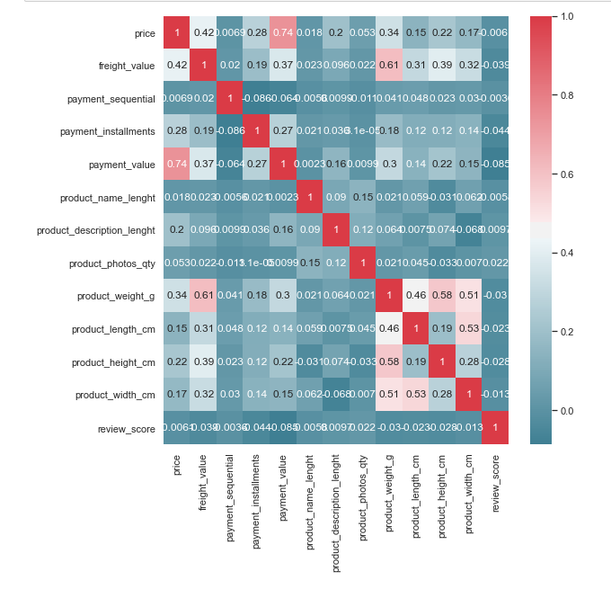
data understanding [80 pts]
[15 points] Explore Joint Attributes
Explore relationships between attributes: Look at the attributes via scatter plots, correlation, cross-tabulation, group-wise averages, etc. as appropriate. Explain any interesting relationships.
Correlation Heatmap →

Slide 12
data understanding [80 pts]
[10 points] Explore Attributes and Class
Identify and explain interesting relationships between features and the class you are trying to predict (i.e., relationships with variables and the target classification).
[5 points] New Features
Are there other features that could be added to the data or created from existing features? Which ones?
day of Week purchase
months of purchase
difference between estimated delivery and actual delivery

Slide 13
exceptional work [10 pts] (solidify that a!)
You have free reign to provide additional analyses.
One idea: implement dimensionality reduction, then visualize and interpret the results.

